Slide 2

Securing the control plane
Administrative credentials
Management interface
Transport of credentials
Credential thefts
Ways of working

Slide 3
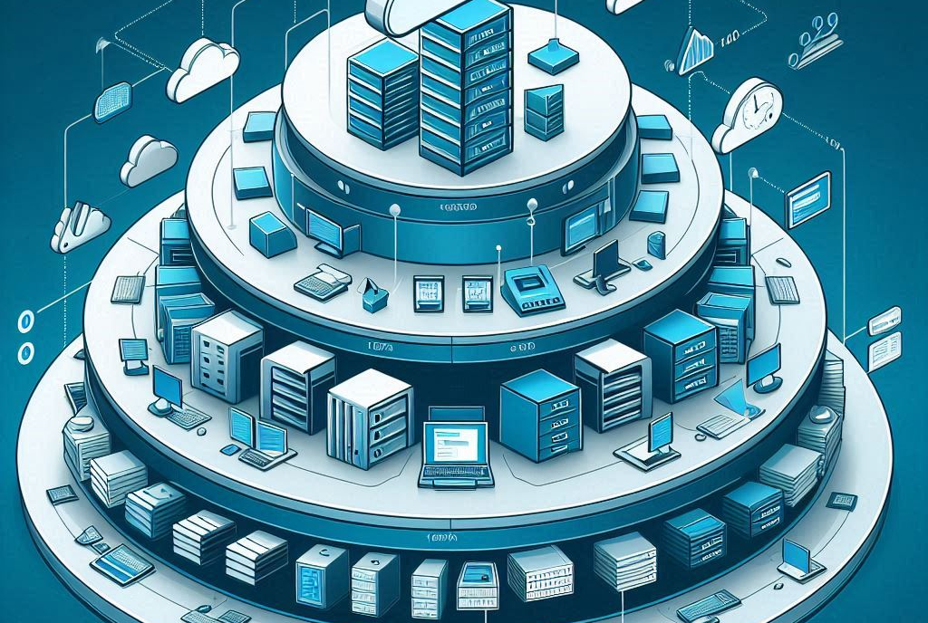
Securing the control plane - Tiering
Tier -2 Virtualization platform
Tier -1 Backup solution
Tier 0 Active Directory and Entra ID
Tier X Servers and applications
Tier E Clients

Slide 4
Demo
Tiering

Slide 5

Note
A Global Admin or Domain Admin is an account used to delegate permissions to Administrators...

Slide 6
Using Tiering, credentials are not exposed
Authentication Id : 0 ; 260686503 (00000000:0f89c2a7)
Session : RemoteInteractive from 9
User Name : User1T1
Domain : DOMAINNAME
Logon Server : (null)
Logon Time : 10/29/2024 8:24:43 AM
SID : S-1-5-21-2117862466-1271736780-543511121-6473
msv :
[00000003] Primary
* Username : SERVERNAME01$
* Domain : DOMAINNAME
* NTLM : 1a9dd7e82e83465e9e537245ed2d6a7e
* SHA1 : 1e815d5f3f51444bbf36945348147e78f2df0698
* DPAPI : 86c85dc1df97957765bad9f6016983e4
tspkg :
wdigest :
* Username : SERVERNAME01$
* Domain : DOMAINNAME
* Password : (null)
kerberos :
* Username : SERVERNAME01$
* Domain : DOMAINNAME.LOCAL
* Password : (null)
ssp :
credman :
cloudap :

Slide 7
Securing the Control Plane - Source
Trust your device
Who can directly or indirectly touch your device?
Clean Source Principle?
Jump hosts?

Slide 8
The PAW

Slide 9
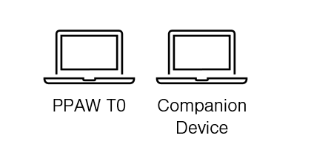
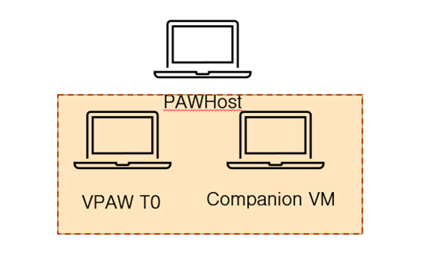

Slide 10
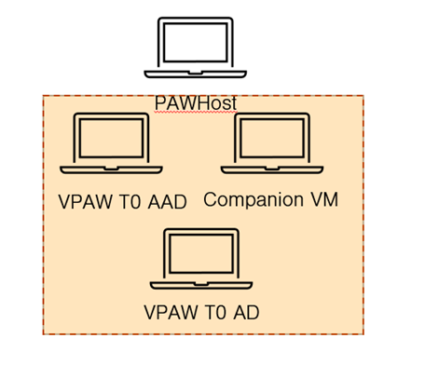
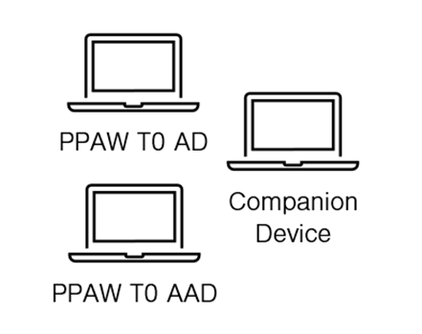

Slide 11


Authentication Policy Silo
Authentication Policy Silo
Kerberos Claims
T0 Admin
T0 PAW
Tier0 Systems

Slide 12
Demo
PAW and Jumphost

Slide 13
The Cloud PAW

Slide 14
The current state (for most)
Cloud management interfaces (PowerShell, UI etc..)
Regular workstation
Admin
MFA via Application / Hardware token

Slide 15
Why is the current state not enough?
The sign in can occur from any device.
Vulnerable to common attack patterns such as:
Info Stealers
AiTM
What can be done instead?
PAW

Slide 16
Preferred state
Conditional Access Policy explicitly granting access from the PAW
Admin
Cloud management interfaces (PowerShell, UI etc..)
Regular workstation
Admin via PIM
MFA via Application / Hardware token

Slide 17
Preferred state
Conditional Access
Device filter
Azure Admin
Azure PAW

Slide 18
Demo
Cloud PAW

Slide 19
Securing the Control Plane - Transport
IP Sec
Network Segment
VPN

